Slide 1
Resetting Government
Data Permissions
$ chmod 444 government_data
Open Data, Proactive Disclosure,
and Crowdsourcing Transparency
May 12, 2017
Aaron Mackey
Frank Stanton Legal Fellow
Electronic Frontier Foundation

Slide 2



What is EFF?
The Electronic Frontier Foundation is a San Francisco-based international non-profit that defends civil liberties at the intersection of technology and the law.
We advocate for transparency, free speech, privacy, and innovation.

Slide 3
“Information is power. But like all power, there are those who want to keep it for themselves”
Aaron Swartz
Guerilla Open Access Manifesto

Slide 4
Current state of access to government data
Individuals must pull data from government
  Time consuming (file a request, wait)
  Can be expensive
  Frustrating – information asymmetry

Slide 5
The long, sometimes sad, life of a request for data

Slide 7
How it should work
Government data
Public
Automatic, proactive disclosure

Slide 8

How to flip from pull to push
Advocate for open data laws at federal, state, local level
Push for proactive disclosure laws & policies
Self-help transparency,
grass-roots advocacy

Slide 9
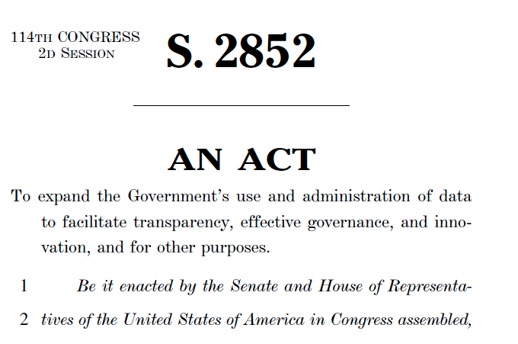
Supporting open data legislation
OPEN Government Data Act
Introduced to codify and expand on President Obama’s open data policies

Slide 10
Key aspects of OPEN Data Act
Requires all federal agencies to automatically make nearly all data public
Data must be shared in machine-readable format (no .pdfs!)
Requires all government data to be shared under public license or dedicated to public domain
Pushes agencies to adopt consistent data storage/sharing practices

Slide 11
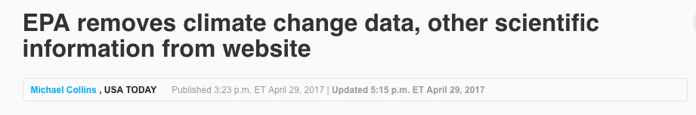

Why we need an open data law

Slide 12
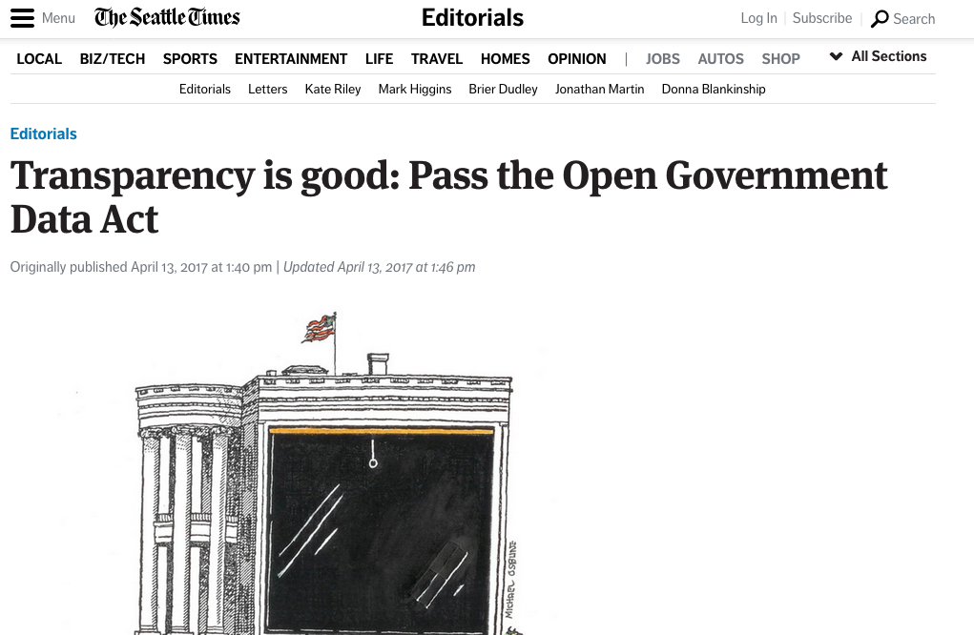

Slide 13
Do your members of Congress support the OPEN Data Act?
Call them and ask
Tell them why it matters
Urge them to support

Slide 14
Proactive data disclosure
Pushing state and local government to make as much data available in accessible formats
Often easier to engage with state, local elected officials to get results (can also tailor based on needs & resources)

Slide 15
Goals of proactive disclosure
Change officials’ mindset from responding to requests to affirmatively disclosing
Create centralized hub for all records/data that is easily accessible and usable
Leverage existing resource, institutional and community knowledge to make disclosure easy

Slide 16
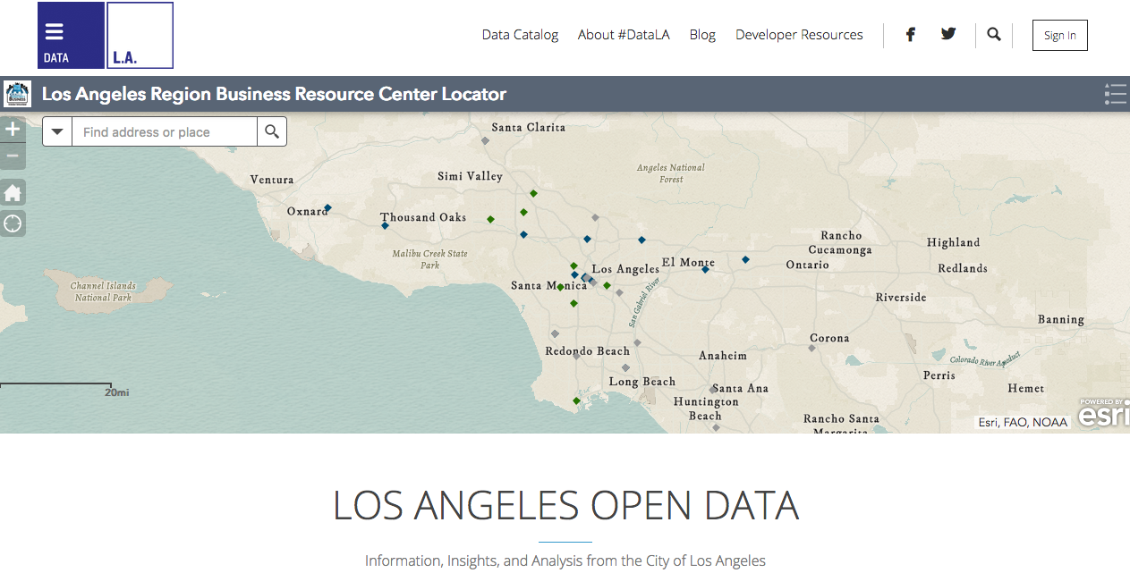
Examples
https://data.lacity.org

Slide 17
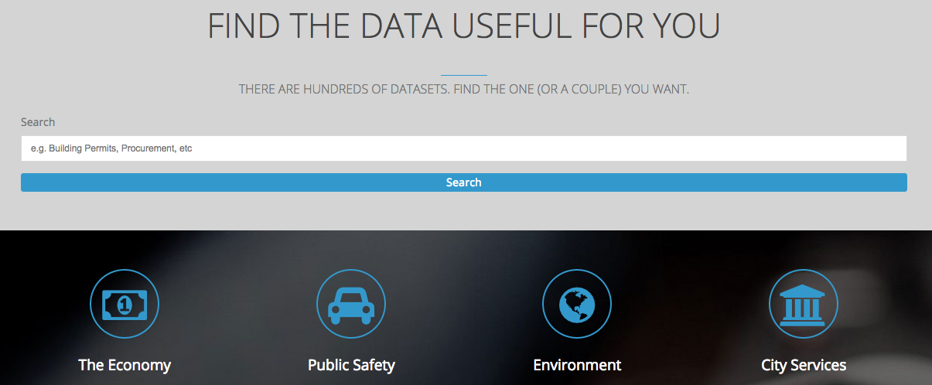
Examples
https://data.lacity.org

Slide 18
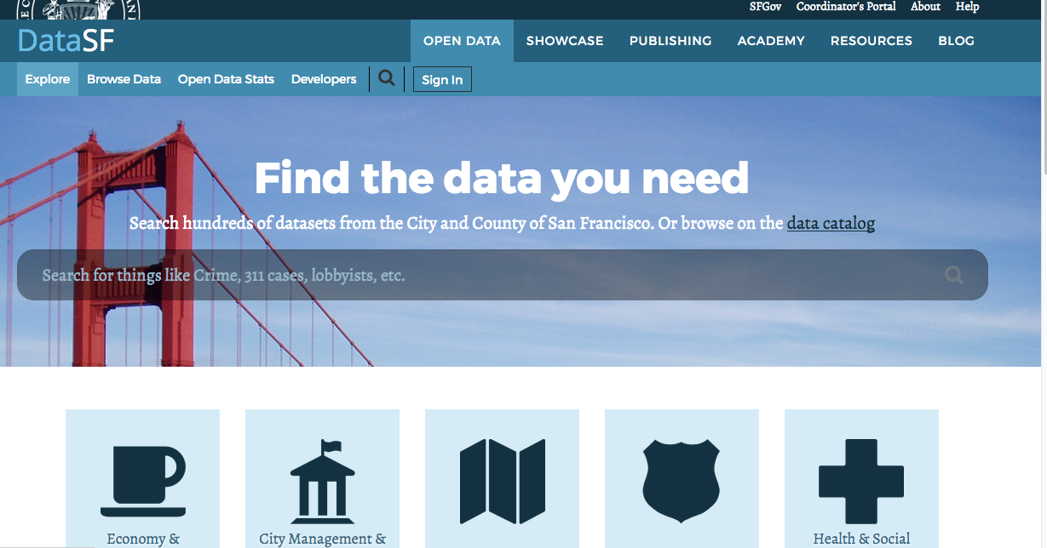
Examples
https://datasf.org/opendata/

Slide 19
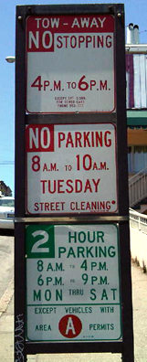
???
???

Slide 20
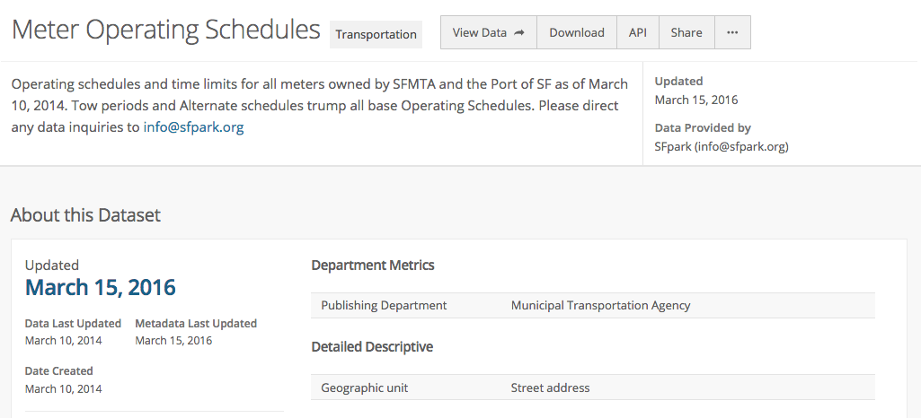
https://datasf.org/opendata/

Slide 21

Crowdsourcing transparency
Host a database hunt to find government data that is currently available but obscured

Slide 22
Example: California Database Hunt
August 27, 2016
EFF – Data Foundation – Sunlight Foundation
Recruited volunteers across country
Assigned them government agencies one at time
Directed them to Google Form to post links and observations

Slide 23
California Database Hunt Results
4 hours – Sprint/hackathon
40+ Volunteers from around the country
680 Agency websites searched
Prioritized: Counties, Cities, Gov. Assoc., Transportation Agencies, Airport agencies
430 S.B. 272 catalogs located

Slide 24
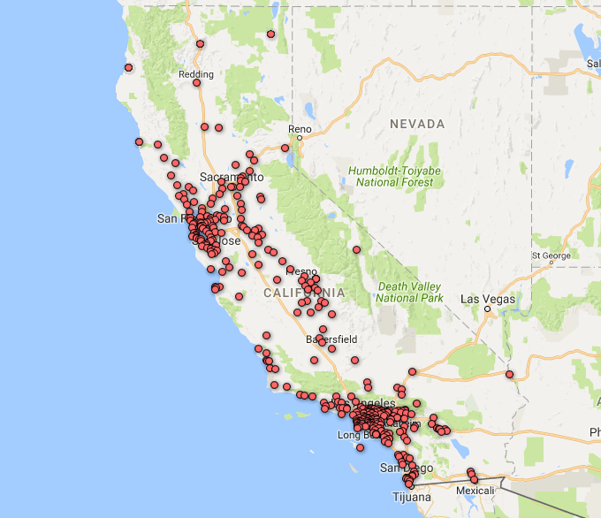

Slide 25
Survey of Ease of Discovery
When volunteers found a catalog, they were asked to rank how easy it was to find on a scale of 1-5, with 1 being difficult and 5 being very easy.
AVERAGE SCORE: 4
More than half of the agencies scored 5

Slide 26
Formats
Of 440 agencies:
PDF – 348
HTML - 63
Exportable in Multiple Formats – 14
Excel/CSV – 13
Microsoft Word – 1
Google Doc – 1

Slide 27
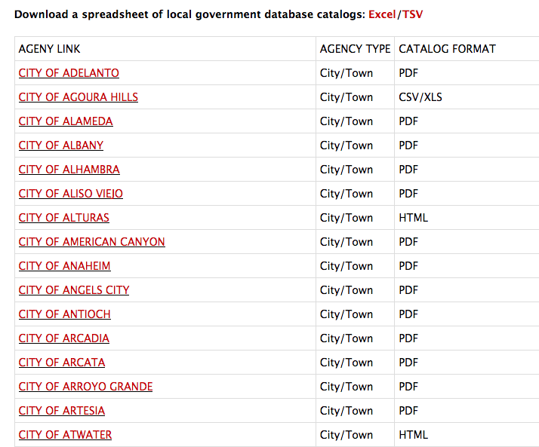
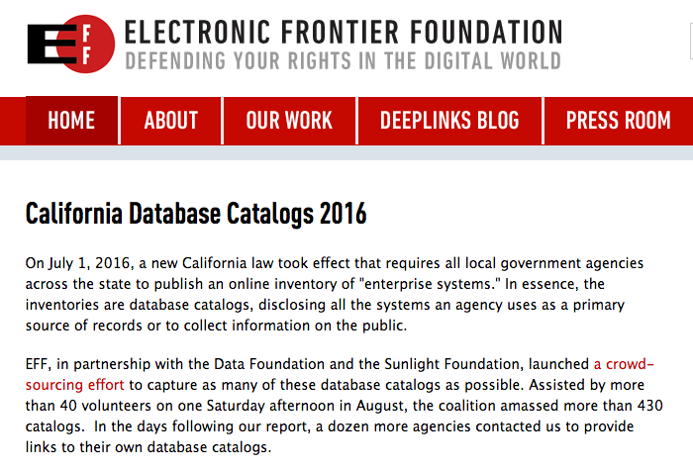
Learn more about the hunt
https://www.eff.org/pages/california-database-catalogs-2016

Slide 28

How to get started
  Start small: critical mass = 3
    EFF can help expand grassroots visibility
    Do you want it?
  Take action
    Lightest lift
      Screen a doc film at a comm’ty center or school
      Host a discussion
      Circulate a sign in sheet

